Slide 1
Ethics in critical care medicine
James Dinwiddie, PA

Slide 2
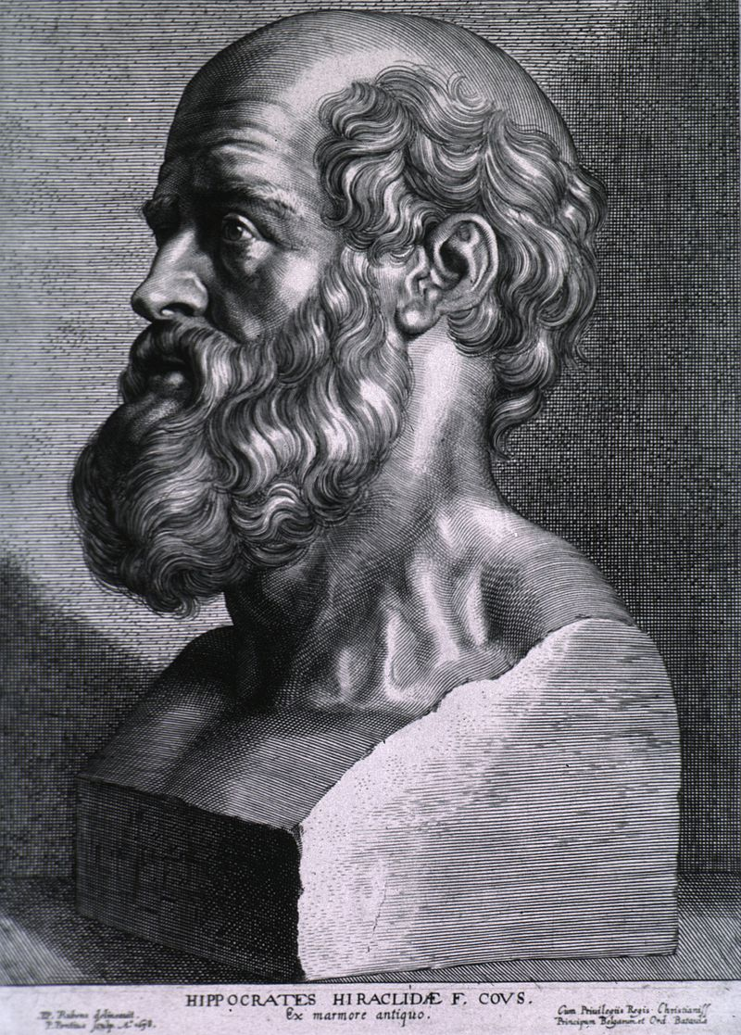
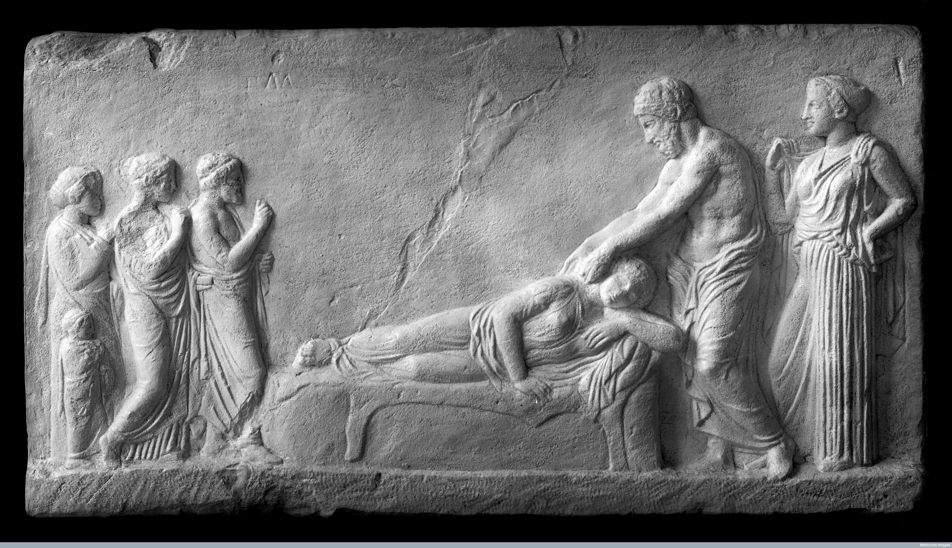
Hippocratic Guild
(350 – 150 BC)
Notes:
We don’t know a lot about Hippocrates himself. What we know about is the Hippocratic Guild which consistent of medical practitioners.
Completely changed the face of medicine in Greece.

Slide 3
Hippocratic Guild (350-150 BC)
Differentiated the cause of disease
Took detailed records
Began developing prognoses
Had a strong code of ethics
Notes:
Important things they did:
Differentiated the source of disease from supernatural causes. Smallpox, malaria, tuberculosis, and seizures were common in that era. The causes of illness were thought to be related to angering the Gods or not giving the appropriate gifts to various Gods. (Fun fact, daughters of God of health were Hygeia and Panacea)
Took really good records. We have over 70 books written by the Hippocratic Guild which include detailed physical exams and observations
Began developing prognoses. They would attempt to understand/predict what would happen
Strong code of ethics. Possibly their biggest contribution. They called medicine “The Great Art.’ A few of their precepts include
With purity and holiness I will pass my life and practice my art.
Where there is love of mankind, there is also love of the art.
First, do no harm

Slide 4
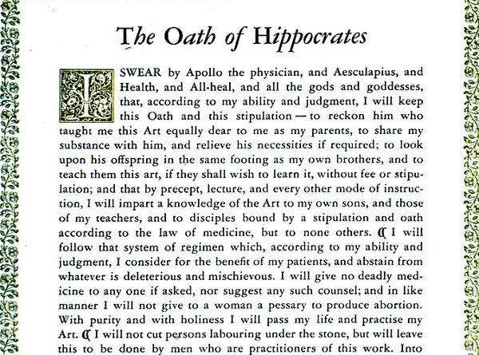

Slide 5
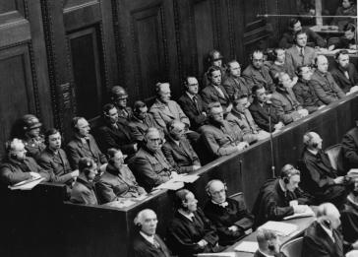
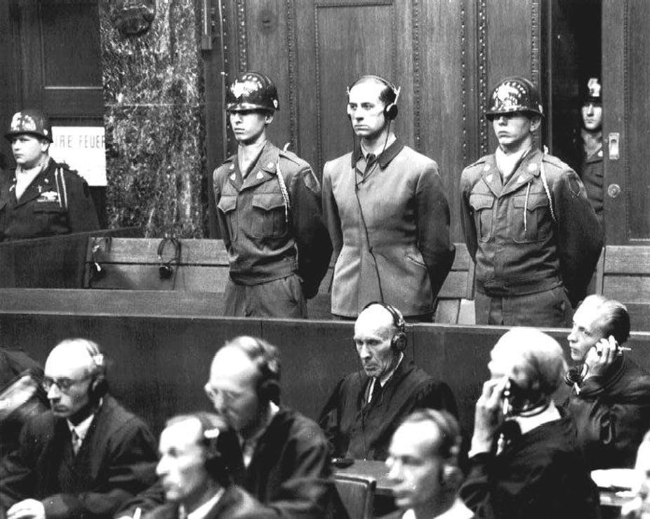
The Nuremberg Code (1947)
Notes:
Drafted after the Nuremberg War Crimes Tribunal following World War II.
As part of the overall Tribune, a “Doctor’s Trial” was held, in which 23 Nazi doctors and officials involved in unethical medical practices such as: human experimentation in concentration camps, forced sterilization, mass murder under the guise of euthanasia, etc

Slide 6
The Nuremberg Code (1947)
Informed consent
Avoiding unnecessary risks
Freedom to leave studies

Slide 7
Contemporary Issues in Medical Ethics
Confidentiality
Patient dignity and safety
Mental capacity
Medical malpractice
Advanced directives
Professionalism

Slide 8
Have you experienced an
ethical dilemma?

Slide 9
Case
Study

Slide 10
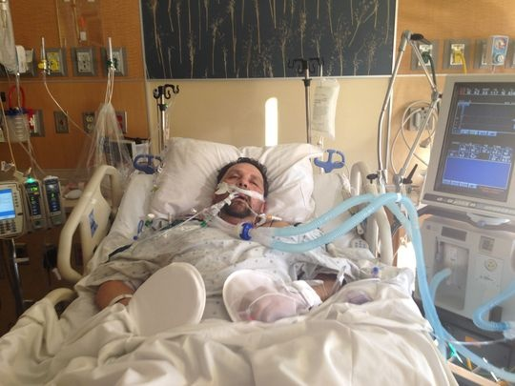
CASE STUDY
58 year-old male, out of hospital v-fib arrest
No CPR until EMS arrived 8 minutes later
ROSC after 10 minutes ACLS
3 days later, in ICU on mechanical vent.
Unresponsive to painful stimuli
Pupils fixed and dilated
Absent corneal reflexes

Slide 11
Who should make medical decisions?
What are the goals of care?
Should further therapy be limited
or withdrawn?
What dilemmas might arise in
discussion with the patient’s family?
What process should be used to
address these ethical issue?

Slide 12
Addressing Ethical Issues
Determine medical facts
Apply ethical principles
Communicate clearly and truthfully
Identify the decision-maker
Develop consensus
Recognize conflicts
Involve ethics teams
Document

Slide 13
Ethical Principles
Respect for Autonomy: The right to
be self-directing
Beneficence: Obligation to act in the
best interest of the patient (Do Good)
Non-maleficence: Obligation to do
no harm without compensating benefit
Justice: Duty to treat all patients
fairly and equitably

Slide 14
Respect for Autonomy
The right to be self-directing
How do you apply the principle of
respect for autonomy to this case?
How do we know what a previously
capacitated patient would want?

Slide 15
Incompetency vs Lack of Capacity
Incompetency
Lack of Capacity
Determined by a court.
A judgement that a person lacks the abilities required to give or withhold informed consent.
Lack of ability to make informed, voluntary decisions in a specific circumstance; because of medications or illness

Slide 16
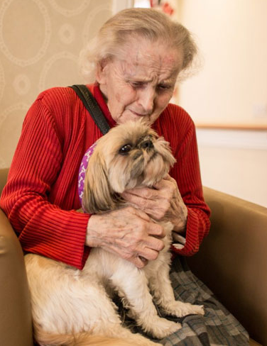
Autonomy in Incapacitated Patients
Advanced Medical Directive | “Living Will”
Verbal or written instructions that take effect in the future when certain conditions are met.
Durable Power of Attorney for Healthcare
Proxy directive that assigns one person authority to perform specified actions on behalf of the signer.
“Durable” as it continues in state of incapacitation
Healthcare Proxy or Surrogate
Appointed by the patient to make healthcare decisions.
Next of Kin
Decision making authority based on a surrogacy hierarchy.

Slide 17
Unambiguous Living Will

Slide 18
No advanced directives, and his wife
is the decision-maker
How would you communicate
his prognosis?
What would you recommend?
Is further treatment “medically futile”
or potentially inappropriate?

Slide 19
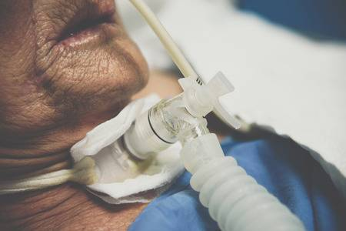
Dimensions of Medical Futility
Refers to medical interventions that are highly unlikely to contribute to a beneficial outcome.
- Predicted outcome
- Available medical evidence or experience
- Determining what counts as a benefit
and who determines this
Who determines when treatments are
medically futile (inappropriate)?

Slide 20
Shared Decision Making
Medical Professionals Provide
Knowledge, Information, and Experience
Patient and Family Provide
Goals and Values

Slide 21
Medical team feels life-sustaining
treatment is inappropriate
Wife wants everything done
There are differing concepts of what
counts as a harm and benefit
Now what?

Slide 23
Case Study Continued…
1 month later, patient has a trach and is in
the IMCU awaiting transfer to an LTAC
He has developed urosepsis and is
hemodynamically unstable
A transfer to the ICU is being requested,
however, the ICU is full
Should you send out the patient with recent
ischemic CVA who has been showing signs
of alcohol withdrawal but is not ventilated?

Slide 24
Triage
Demand for ICU beds often exceeds supply
Objective admission criteria
Seeking to maximize the good for all, not just the individual patient
Who should make the decision regarding admission to the ICU?

